Slide 1

Acropolis Institute of Technology & Research, Indore
www.acropolis.in

Slide 2

TASK TRACKING TOOL
TaskMitra
Your Trusted Partner in Streamlining and Managing Tasks with Ease
Submitted To
Prof. Nivedita Tiwari
Department Of Information Technology

Slide 3
Team Members
Kashish Sharma (0827IT211058) Gaurav Joshi (0827IT211038) Astha Jain (0827IT211020)
Supervised by Prof. Shahida Khan

Slide 4
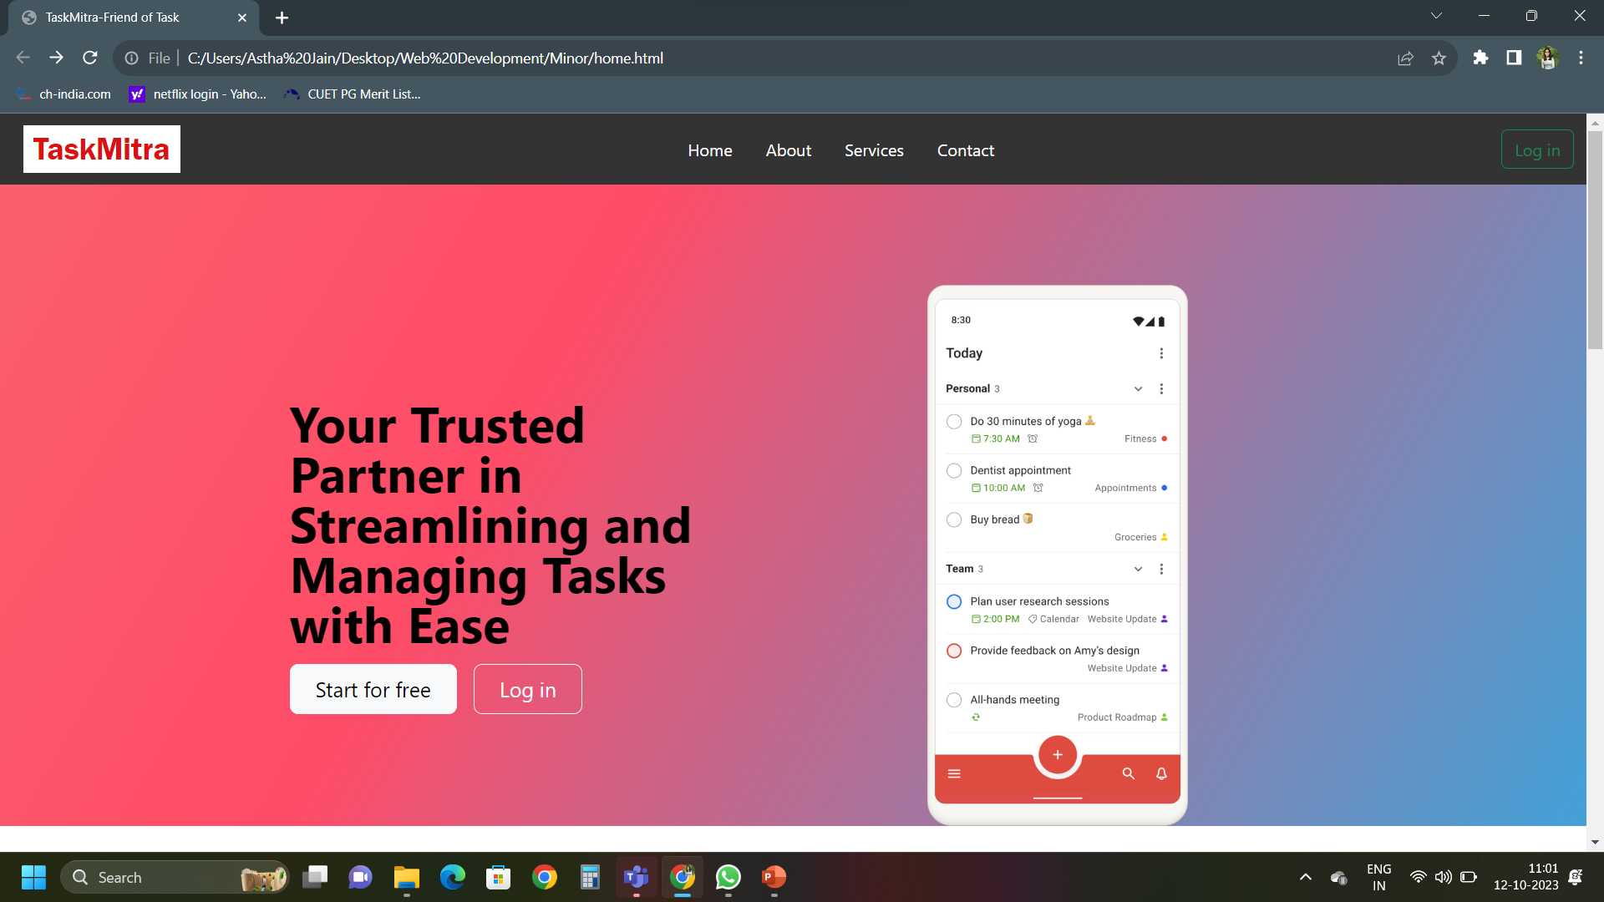
User Interface

Slide 5
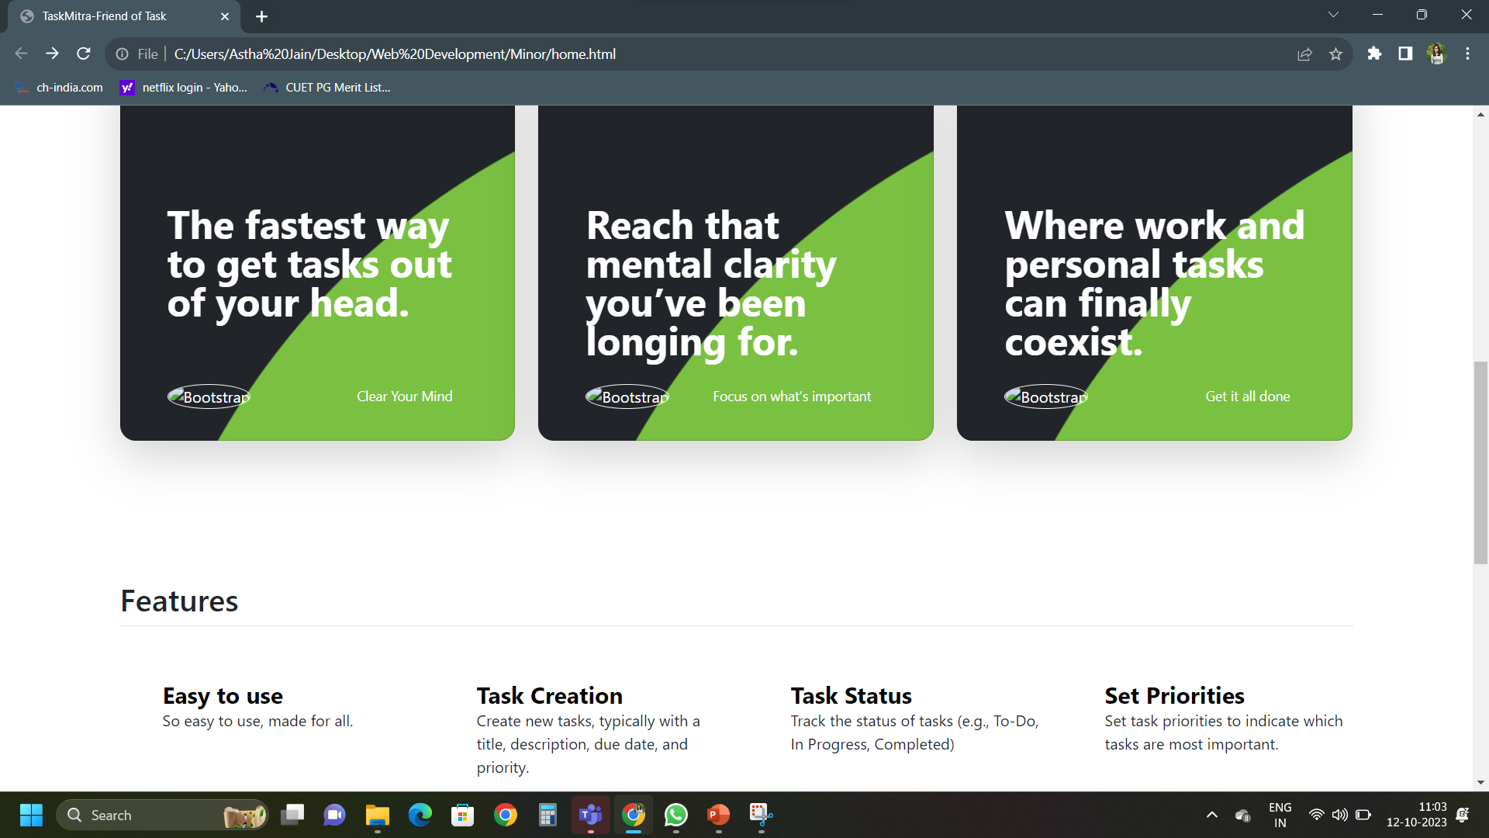

Slide 6
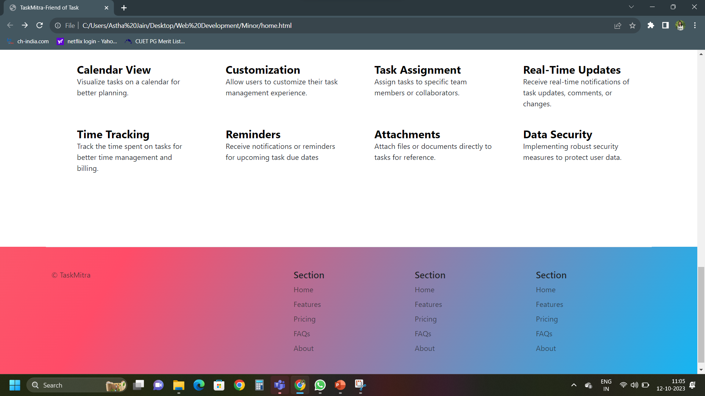

Slide 7
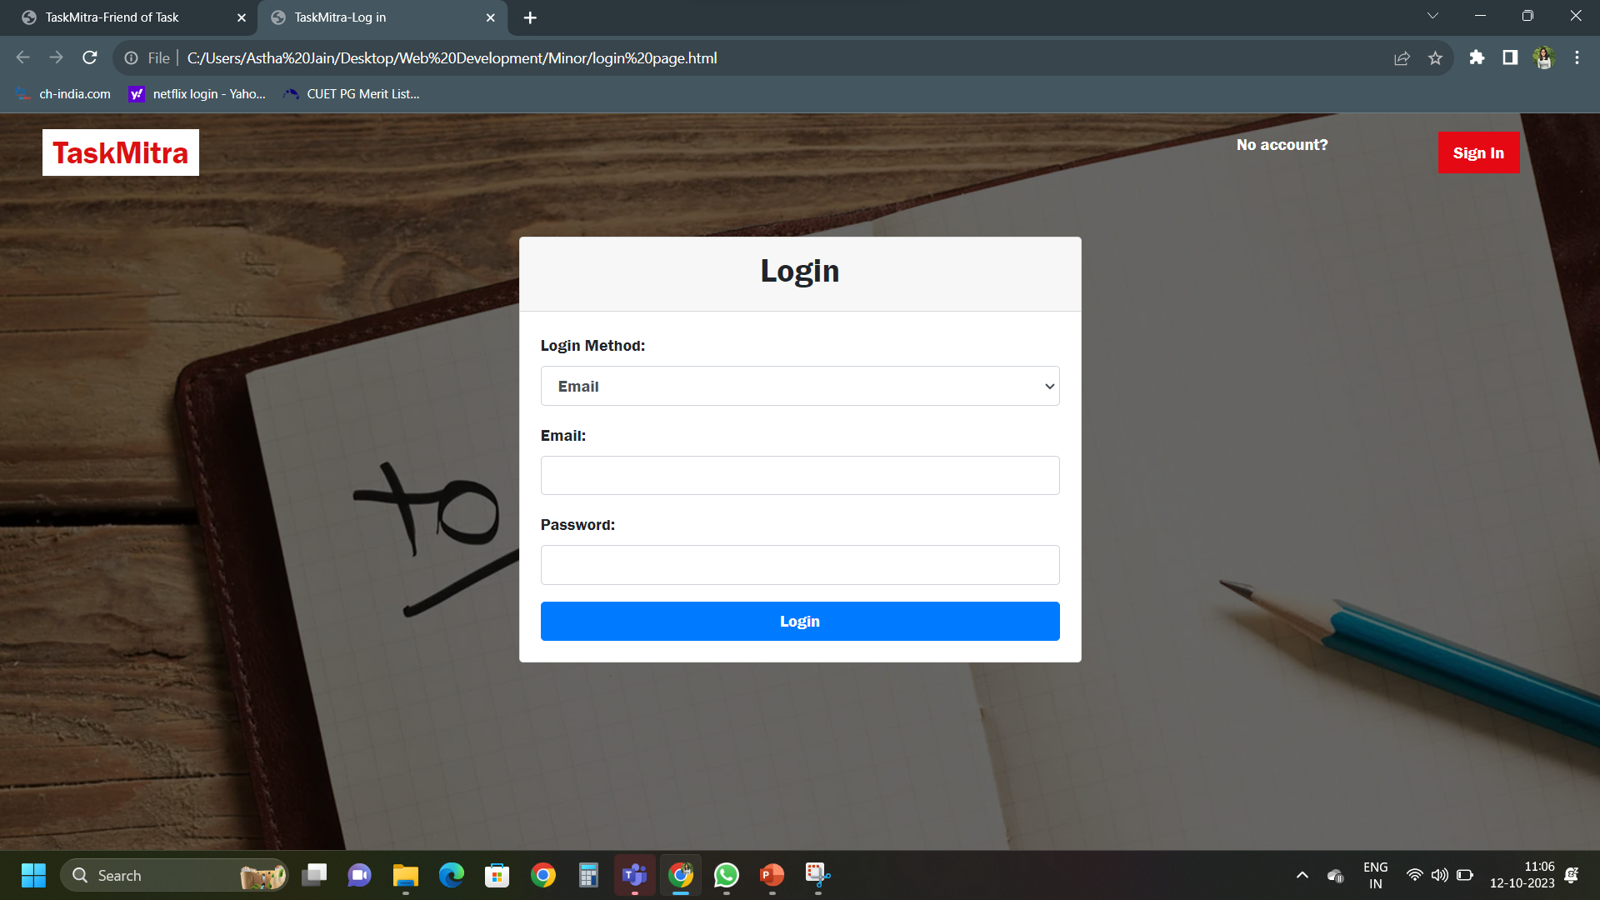

Slide 8
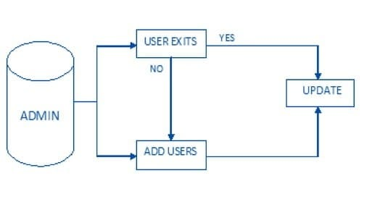
Admin Module

Slide 9
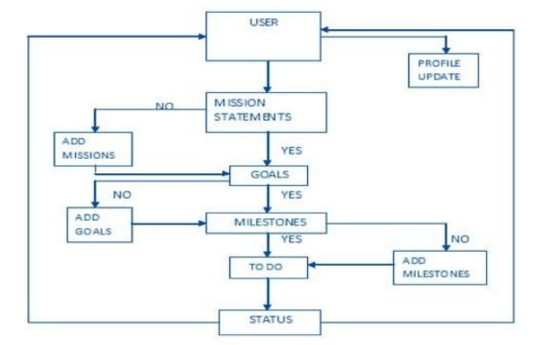
User Module
‹#›

Slide 10
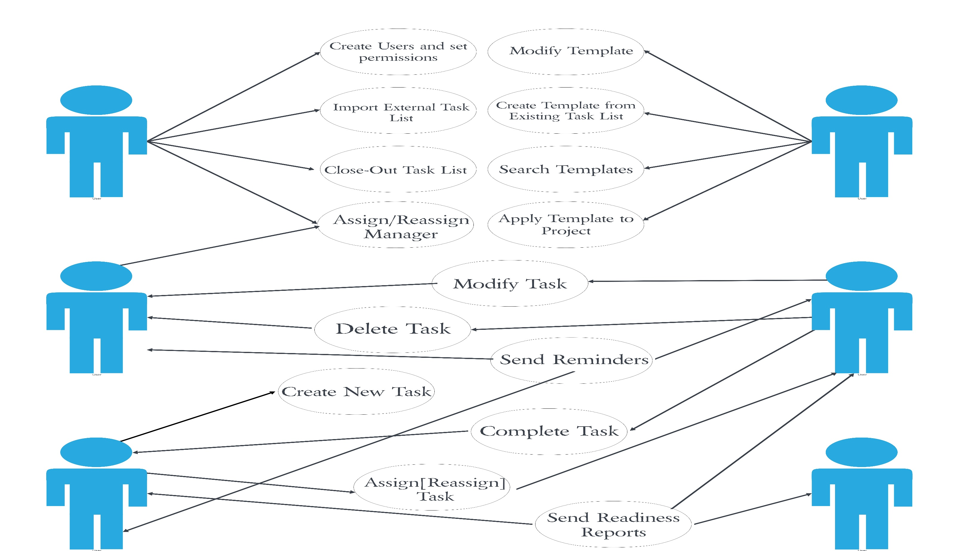
Use Case Diagram
Admin
Templet Manager
Project Manager
Assignee
Task Manager
Viewers

Slide 11
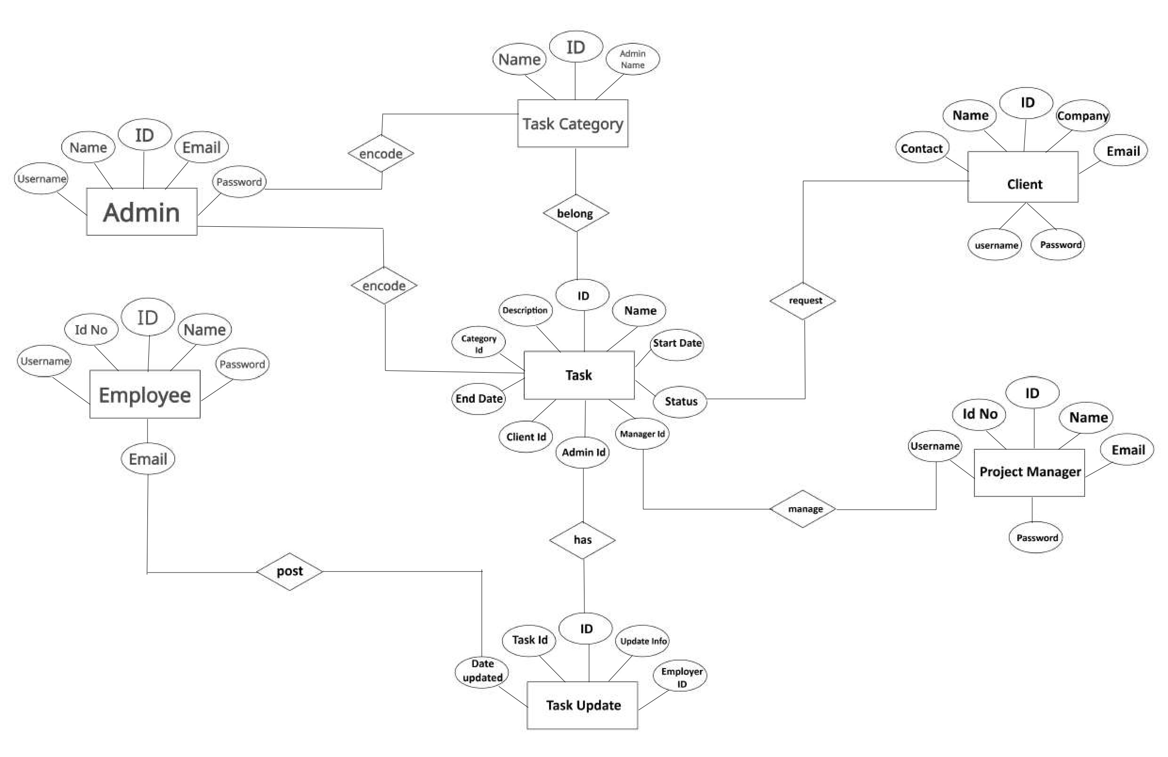
E-R Diagram

Slide 12
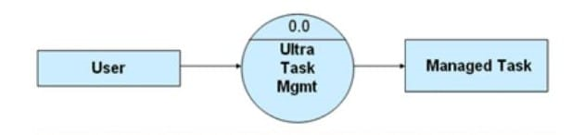
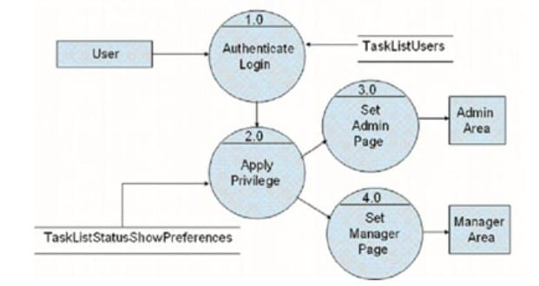
Data Flow Diagram

Slide 13
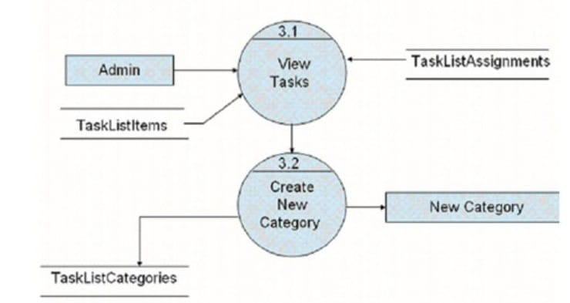
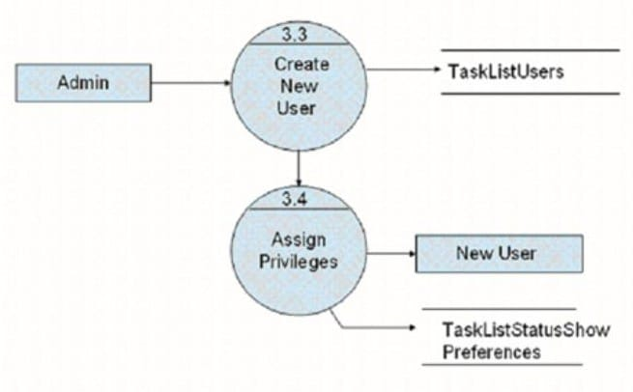

Slide 14
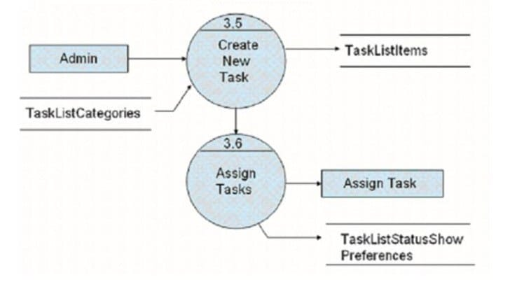
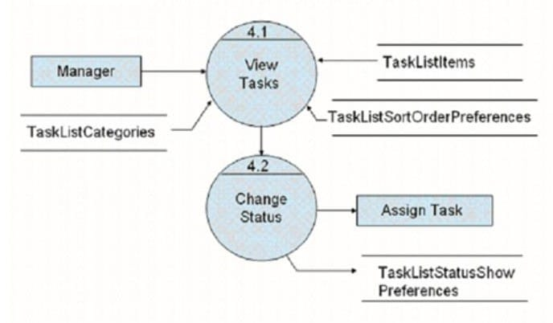

Slide 15
Acknowledgment
We extend our heartfelt thanks to our project team, our guide Ms. Shahida Khan, project coordinator Ms. Nivedita Tiwari, institution, and reviewers for their essential contributions and support. We eagerly anticipate presenting our project and appreciate your guidance and encouragement.

Slide 16
Q&A
‹#›

Slide 17
THANKS
‹#›

